Slide 1

Implement Anomaly Detection Sample
Supervised By: Damir Dobric / Prof. Dr. Andreas Pech
Group Name: Team_Anomaly_Detection
Members:
Mahbubur Rahman
Md Zihadul Islam Joni
Md Rakibul Islam

Slide 2
Overview
Introduction
Implementation
Results
Conclusion
References
Project Objective

Slide 3
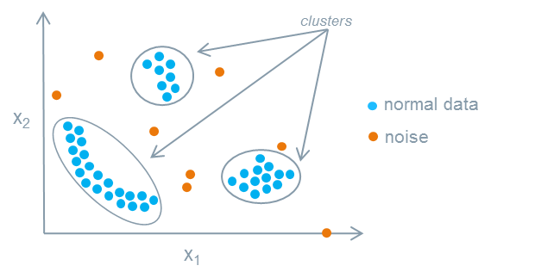
WHAT IS ANOMALY? Deviations from the expected value of an event within a group
Anomaly detection is an important technique used in many fields and applications. A recent trend in the field is that more and more applications and systems are being built to detect anomalies continuously in real time. Detection of anomalies is a major issue that has been studied for centuries, but it is only recently that there has been an increase in the number of methods for detecting these outliers. Numerous distinct methods have been developed and used to detect anomalous patterns for different applications. An example of medical application is heart rate monitors, where a shock at a certain interval indicates an irregular rhythm. Other examples include fraud detection, loan application processing or monitoring of medical conditions, cyber security intrusion detection systems that monitor server logs for abnormal activities, fault detection for aviation safety studies
Introduction

Slide 4

HTM (Hierarchical Temporal Memory) is a machine learning algorithm that processes time-series data in a distributed manner using a hierarchical network of nodes. Each nodes, or columns, can be trained to learn, and recognize patterns in input data. This can be used in identifying anomalies/deviations from normal patterns. It is a promising method for predicting and detecting anomalies in a range of applications. In this project, we will train our HTM Engine using the multisequencelearning class in the NeoCortex API, and then use the trained engine to learn patterns and identify anomalies. Specifically, numerical sequences will be read from various CSV files inside a folder in order to create an anomaly detection system.
PROject objective

Slide 5
methodology
We are going to use multisequencelearning class of NeoCortex API as base of our project. It will help use with both training our HTM model and using it for prediction. The class works in the following way:
HTM Configuration is taken and memory of connections are initialized. After that, HTM Classifier, Cortex layer and HomeostaticPlasticityController are initialized.
After that, Spatial Pooler and Temporal Memory is initialized.
After that, spatial pooler memory is added to cortex layer and trained for maximum number of cycles.
After that, temporal memory is added to cortex layer to learn all the input sequences. e. Finally, the trained cortex layer and HTM classifier is returned.

Slide 6
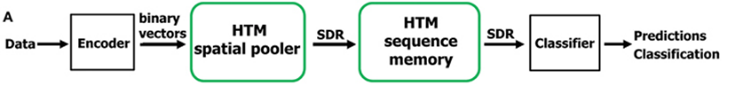
Methodology (Cont.)
Hierarchical Temporal Memory (HTM)
Machine learning algorithm based on the core principles of the Thousand Brains Theory.
Takes inspiration from neocortex of human brain.
Hierarchical Temporal Memory Cortical Learning Algorithm (HTM CLA): Tries to simulate the way neocortex processes information in human brain.
Can be used process information, recognize and identify patterns and make future predictions based on past learning.
Promising approach for anomaly detection and prediction in a variety of applications in sectors, such as healthcare, finance, etc.
6

Slide 7
Methodology (Cont.)
Multisequence learning
Htm cla is good is finding patterns in data
We are using neocortex api, specifically multisequence class, which is based on htm cla.
Multiple number of sequences can be trained with different datatypes.
We are going to use simple numerical integer sequences.
We have to tune hyper-parameters, like encoder and htmconfig, which facilitates training this type of data.

Slide 8
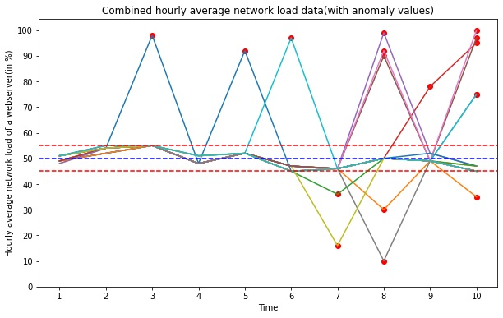
Methodology (Cont.)
Anomaly detection
We have taken an artificially generated dataset and trained our htm engine.
We have added anomalies to random indexes in our prediction data.
We will try to train our data and detect anomalies using trained htm engine.

Slide 9
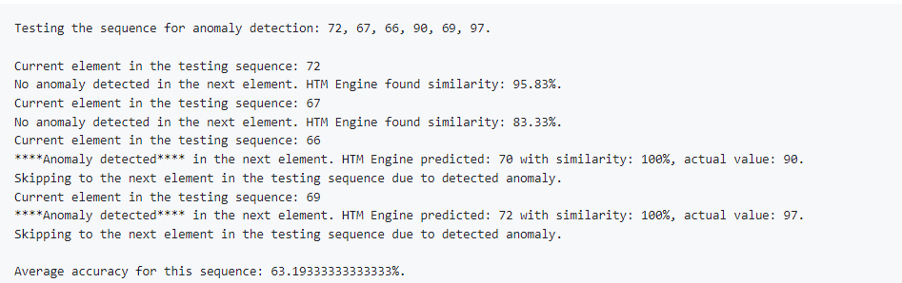
We can observe that the accuracy rate is between 50% - 70%. It is desired that high accuracy should on the sequence is required in an anomaly detection program. Due to hardware specification of our machine, we unable to run the program with lots of cycle and sequence. However, accuracy can be improved by running more data sequence and cycle.
One example of testing sequence for anomaly detection and average accuracy for this sequence given below:
results

Slide 10
conclusion
Low False Negative Rate (FNR) is crucial in anomaly detection, particularly in sensitive areas like fraud detection, to avoid overlooking anomalies and wasting resources on unnecessary investigations.
Hierarchical Temporal Memory (HTM) stands out for real-time anomaly detection without pre-training, making it ideal for dynamic data streams and resilient to noise.
Enhanced computational resources and time allocation, potentially through cloud platforms, can optimize HTM model performance by allowing for more data and hyperparameter tuning in anomaly detection applications.

Slide 11
references
[1] Y. Cui, S. Ahmed, and J. Hawkins, “The HTM Spatial Pooler—A Neocortical Algorithm for Online Sparse Distributed Coding,” Front. Comput. Neurosci. November 2017, vol. 11-2017, doi: 10.3389/fncom.2017.00111.
[2] Ahmad, S., Lavin, A., Purdy, S., and Agha, Z. (2017). Unsupervised real-time anomaly detection for streaming data. Neurocomputing 262, 134–147. doi: 10.1016/j.neucom.2017.04.070.
[3] Mnatzaganian, J., Fokoué, E., and Kudithipudi, D. (2017). A mathematical formalization of hierarchical temporal memory's spatial pooler. Front. Robot. AI 3:81. doi: 10.3389/frobt.2016.00081.
[4] K. Mountcastle, V. B. (1997). The columnar organization of the neocortex. Brain 120, 701–722. doi: 10.1093/brain/120.4.701.
[5] Olshausen, B. A., and Field, D. J. (2004). Sparse coding of sensory inputs. Curr. Opin. Neurobiol. 14, 481–487. doi: 10.1016/j.conb.2004.07.007.
[6] Y. Cui, S. Ahmed, and J. Hawkins, “Continuous online sequence learning with an unsupervised neural network model,” Neural Computation, Volume 28, Issue 11, November 2016, pp 2474–2504, doi: 10.1162/NECO_a_00893

Slide 12

Thank you

